Slide 1
301, Oct 27, Class 18
Salovich et al. (2025)
Rigor and Reproducibility in Psychological Science
Final Project Proposal process
  Getting started

Slide 2
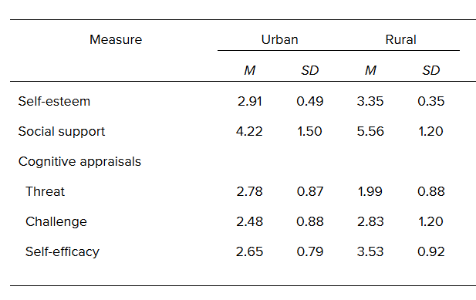
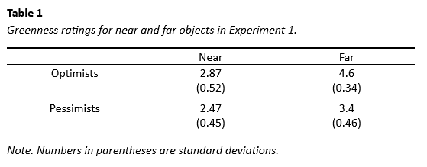
Means Tables
Means table
APA example
Also acceptable with
SD in parentheses under
the means

Slide 3
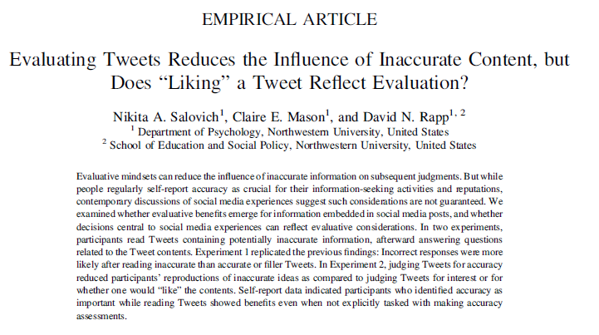

Slide 4
What is the design of Experiment 1 by factors and the levels of each factor?
What is the key dependent variable used in the main reported analysis?

Slide 5
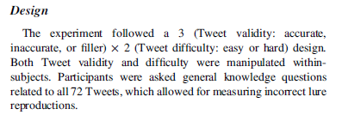
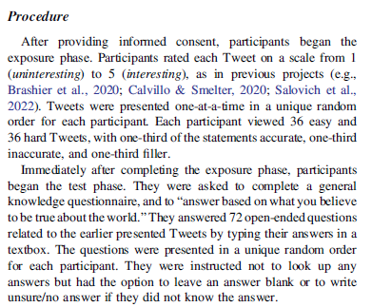

Slide 6
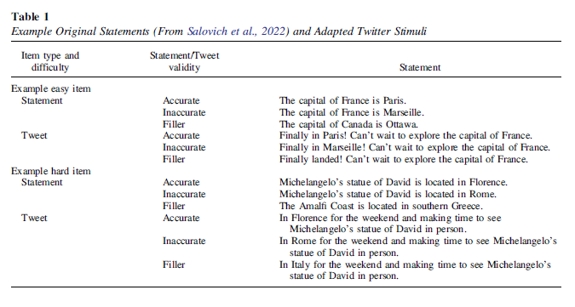

Slide 7
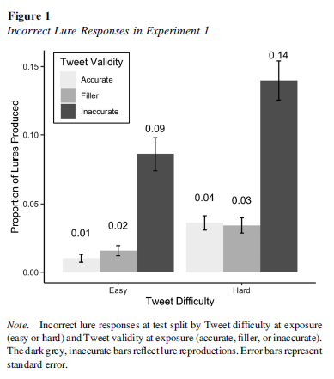
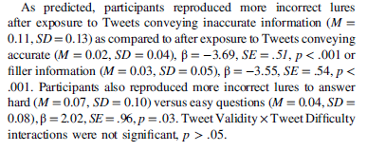

Slide 8
What were the levels and design of Experiment 2?
What was the primary conclusion of Experiment 2? (The Discussion section opens with a review of this)

Slide 9
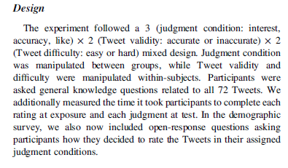
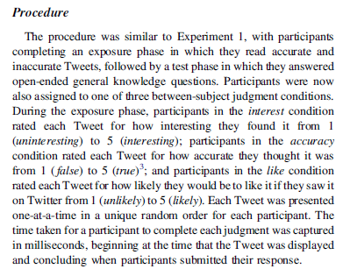

Slide 10
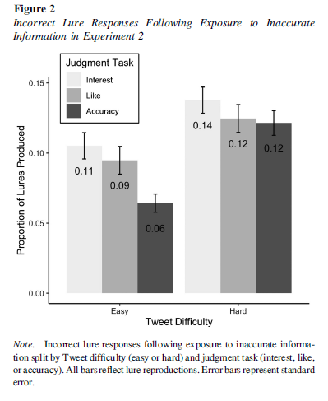
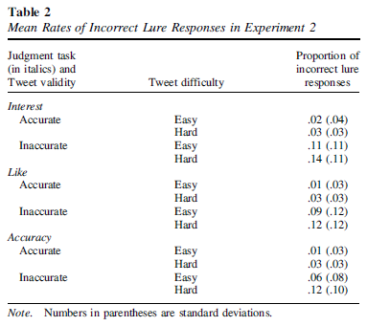

Slide 11
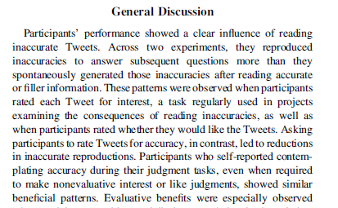

Slide 12
Reproducibility and Rigor in Science
Finding: some well-known psychological science studies were found to “not replicate”
  Known as the “Replication crisis,” fears of excess Type 1 errors
Good consequences: more attention is being paid to statistical inference
  Reduce focus on p-value, more on effect size and inference
  Replicating findings helps extend theory
Bad consequences: increased distrust of science
  Some ways to increase rigor will lead to less overall science
  Exposing gaps in statistical understanding

Slide 13
Replicating published work
Possible outcomes of redoing a study
  Effect is not reliable in replication
    Type 2 error?
    New sample introduces additional variable (e.g., stereotype threat)?
    Original report was a Type 1 error?
  Effect is again found to be reliable, successful replication
    However, effect size appears smaller
Sample size
  Smaller samples have less power to detect changes
  “Getting lucky” inflates estimates of effect size
    Even for reliable results

Slide 14
Power analysis for sample size
How many participants do I need for my experiment to work?
  Practical/convenience sampling: how many do you have?
  RCT: precisely estimated samples in advance
Probability of a statistically reliable result
  P = f(effect size, n)
Common targets
  80% power = 80% probability of seeing p<.05 assuming the IV has an effect
  Note that 20% of true findings still do not “replicate” (Type 2 error)
Rough estimates
  Cohen’s d = 1.0, n = 32 (16/group), power = 80%
  d = 0.5, n= 126 (63/group), power = 80%
  d = 0.2, n = 784 (392/group), power = 80%

Slide 15
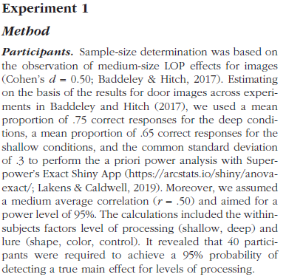
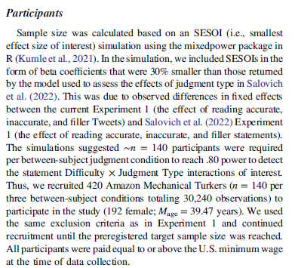
Power Analysis examples
Ovalle-Fresa et al. (2021)
Salovich et al. (2025)

Slide 16
Effect size statistics
Cohen’s d
Generalized Eta-squared
Difference in means divided by the standard deviation
Estimated proportion of variance due to each factor and interaction
Effect Magnitude | Cohen’s d | Generalized eta-squared
Small | 0.2 | 0.02
Medium | 0.5 | 0.13
Large | 0.8 | 0.26
Very large | 1.2 | 0.40

Slide 17
Power and sensitivity
Under-powered studies (too few participants for effect size)
  Might still work if you get lucky
  “Marginal” effects: .05 < p < .10
    One-tailed test would work
“Over-powered” studies
  Not actually possible
  Large n’s can produce tiny reliable effects
    Statistically reliable but not practically important
    Always consider at the effect size when interpreting results

Slide 18
Hidden problematic practices
External influences
  How was the research paid for?
  Did the funding agency have a vested interest in the outcome?
Analytic flexibility
  Digging around in a complex dataset until a “reliable result” is found
  Should require a correction for multiple comparisons
“File drawer” effects
  Re-running studies until they work

Slide 19
Open Practices
Experiment pre-registration
  Semi-publicly post experiment design details before starting
  Requires effect size estimate, detailed analysis plan
  Power analysis for planning sample size
Make all data publicly available
  De-identified
  Ideally pre-analysis, pre-exclusion
Make detailed methods available
  Supplemental Materials
  Analysis scripts

Slide 20
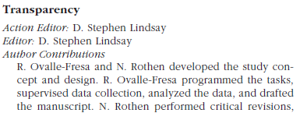
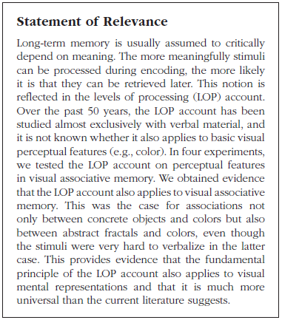
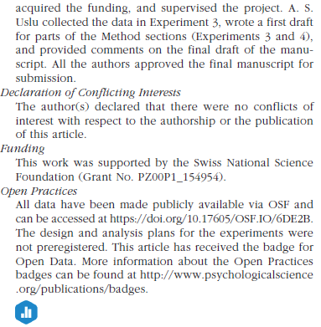
Rigor, Ovalle-Fresa et al. (2021)

Slide 21
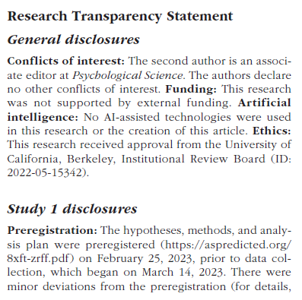
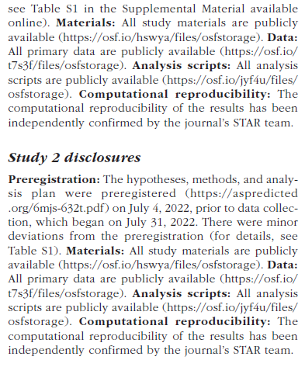
Rigor, Cho & Critcher (2025)

Slide 22
Preparing a Research Proposal
Organize into groups of 3-4 students
  If you have trouble finding a group, email us
Meet and pick out your first main source paper
  Use for operational definitions
  Starting point for procedure
Prepare your initial proposal for Tuesday 10/27

Slide 23
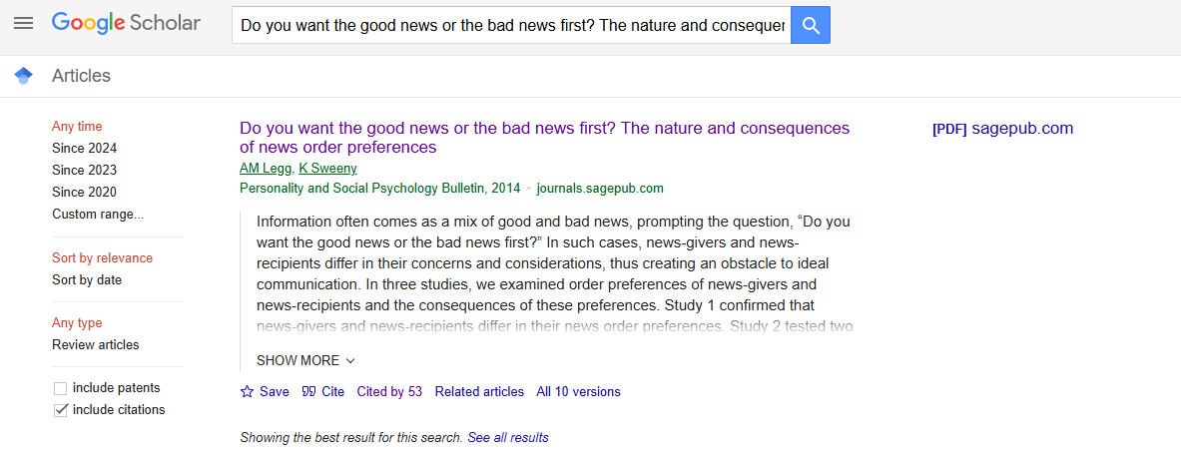
Background research
Missing Find @ NU link
Preformatted reference
Articles that cite your main source.

Slide 24
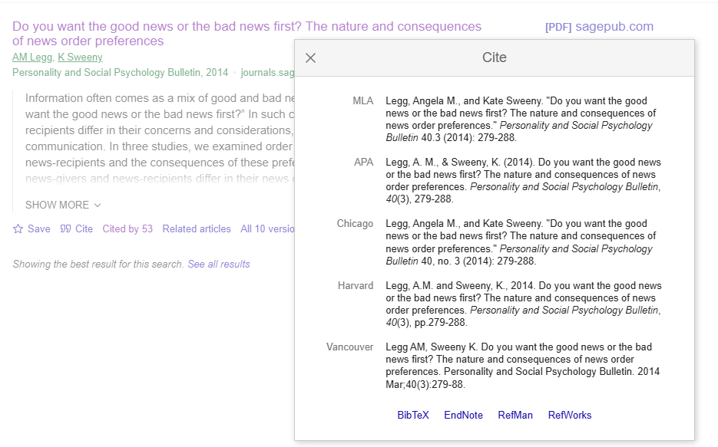

Slide 25
Initial Proposal Outline
Group members
Tentative project title
First background source (APA Reference Style)
Design of source experiment
  IV(s), DV, number of participants, outcome
What new element are you planning to add?
Diagram your 2x2 design
  2 factors, 2 levels each
Planned number of participants
 | Factor1-a | Factor1-b
Factor2-x
Factor2-y

Slide 26
Collaborative Research
Work together on design, data collection, analysis
  Shared Methods & Results section
Work separately on Introduction, Discussion, Abstract
  Make your own figures
  Differing interpretations of the results are possible
  Each paper is your own (first author)
Academic integrity
  Building on other author’s ideas is not plagiarism, citations strengthen papers
  Taking other people’s words as your own is plagiarism
  Data fabrication is fraud

Slide 27
Practical points
Design must be 2x2
  At least one factor must be manipulated across groups
  Randomly assigned
Minimal ethical risk to participants
  No personal/private information
  No deception other than blind to conditions
  No emotional manipulations
Online data collection can be used
  Qualtrics: https://www.it.northwestern.edu/software/qualtrics/index.html

Slide 28
Planning for Final Proposal
Submit to us as if we are the IRB
  Present a full description of your protocol
    Motivating hypothesis
    Procedure as a draft of your Methods section
  All stimuli to be used
    Working version of an online survey including all conditions
No data collection until explicit approval
  Once approved, go as quickly as possible

Slide 29
Research Context
Building on existing work
  Strengthens confidence in conclusions
  Very briefly review theory/mechanism
Adding something new
  What is new about our study?
  Motivate the current study to add to prior work

Slide 30
For Wed Oct 29
Chapter 18, Responsible Conduct of Research
  Questions posted on Canvas
Final project initial ideas (Tuesday)

